Slide 1

MATLAB Implementation of SVM
Professor Bo Liu
James Watt School of Engineering

Slide 2
MATLAB implementation of SVM - fitcsvm
Function fitcsvm is MATLAB implementation of SVM, including linear and nonlinear case.
There are many input arguments of fitcsvm, and we do not need to know all of them.
The most often used code that trains an SVM classifier:
X and Y: feature and label of the training data.
KernelFunction: kernel function of SVM. 'linear', 'polynomial', 'rbf', and 'sigmoid'.
BoxConstraint: determines the trade-off between misclassification and width of margins.
Standardize: boolean parameter that determines whether to standardize the input data before training the SVM, which means subtracting the mean and dividing by the standard deviation of each feature.
See live script

Slide 3

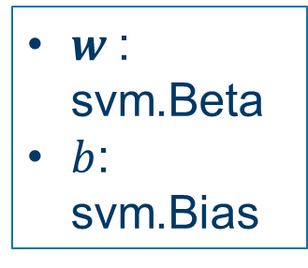
MATLAB implementation of SVM - fitcsvm
Training
The output of fitcsvm is a ClassificationSVM object that represents an SVM classifier.
It stores the support vectors, classifier parameters, etc.
We can retrieve them by using dot notation.
sv = svm.SupportVectors; % Get the support vectors
beta = svm.Beta; % Get the coefficients of the linear classifier
b = svm.Bias; % Get the bias term of the linear classifier
$w$: svm.Beta
$b$: svm.Bias
$${h\left(x\right)=w}^{T}x+b=0$$
See live script

Slide 4
MATLAB implementation of SVM - fitcsvm
Prediction
To predict, pass the trained classifier and the test data to the predict function
% Predict
y_pred = predict(svm, X_test);
Input of the predict function:
svm: the trained SVM classifier.
X_test: the features of the test dataset.
Output: y_pred is the predicted class labels.
It has the same data type as that of y_train.
The length of y_pred is the same as that of X_test.
See live script

Slide 5
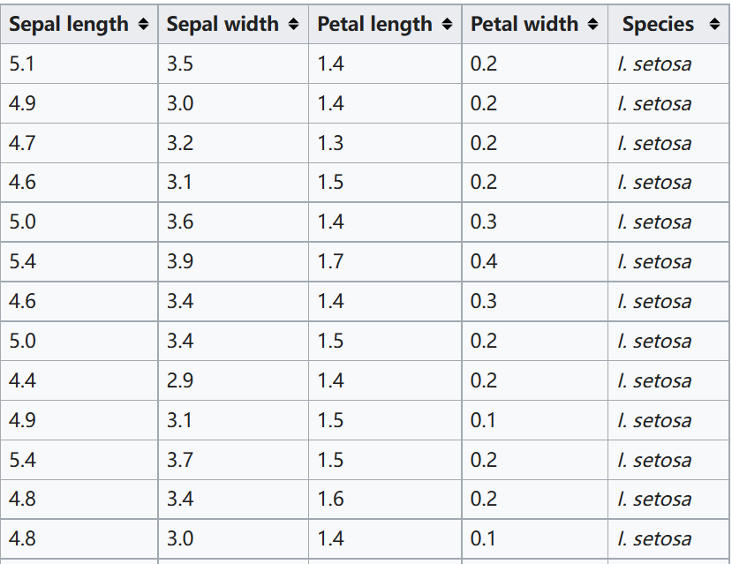
Iris flower classification by SVM using MATLAB
Iris flower classification problem
Features: (sepal length, sepal width, petal length, petal width)
Label: categorical, {setosa, versicolor, virginica}
Number of samples: 150
To make the dataset linearly separable, we only choose:
(sepal length, sepal width)
(setosa, versicolor)

Slide 6
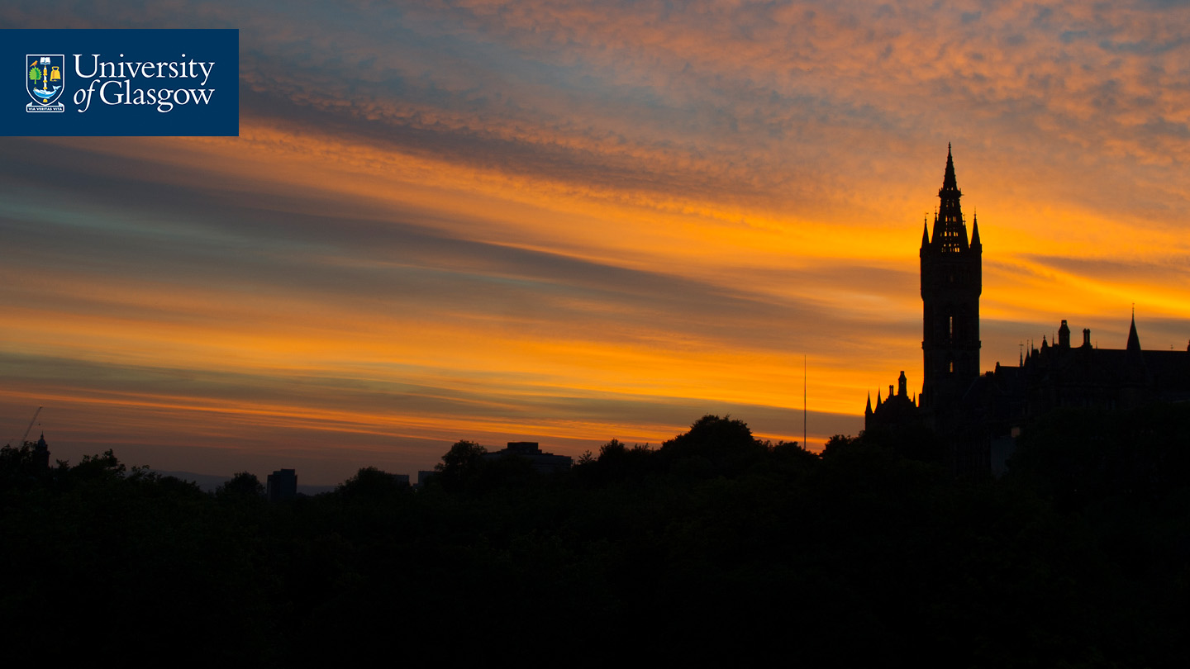



Thanks!
#UofGWorldChangers
@UofGlasgow

